Slide 1
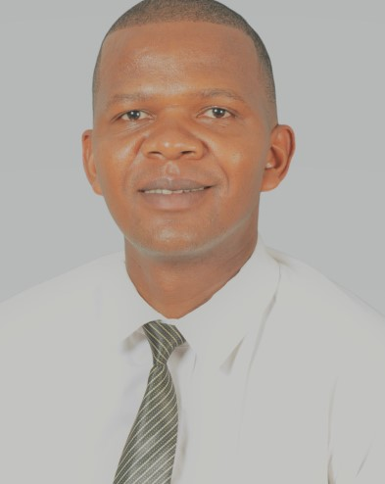
CAREER summary

Slide 2
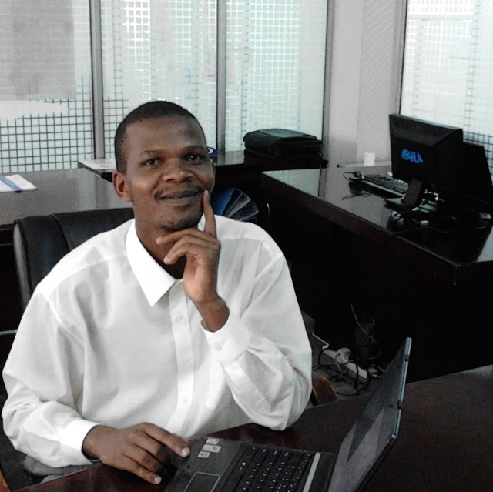
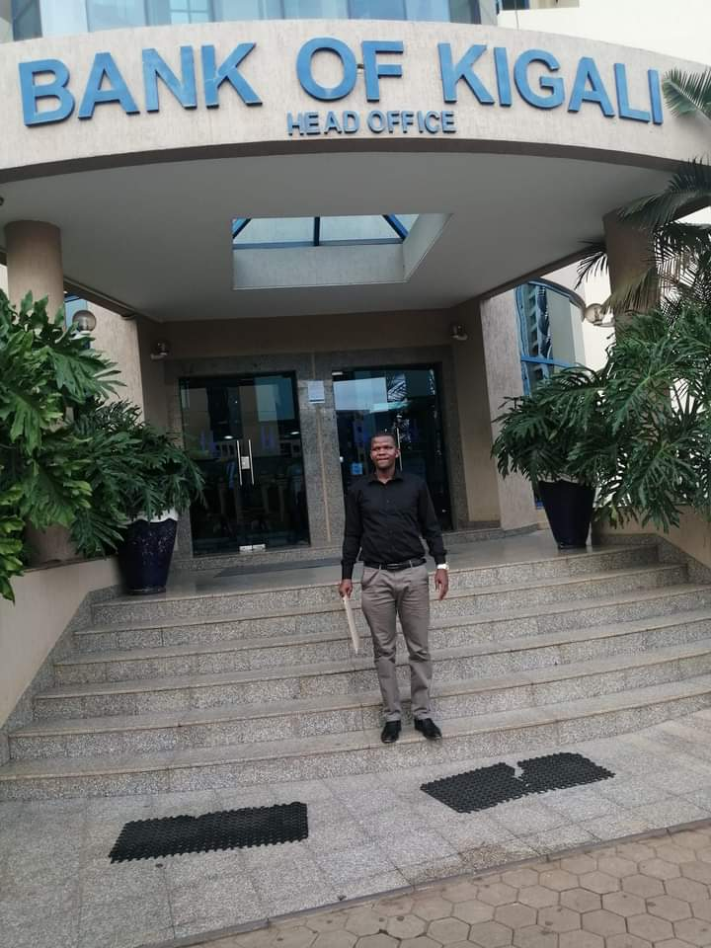


Slide 3


My Career Journey
01
02
03
Systems engineer
Software developer
Lead Software Developer
Network support and VB.net software development
PHP & JAVA 7
Java 7/Spring 2.4
06
05
04
IT Solution Architect
Technical BA
Tech Lead/Systems specialist
Java/TIBCO/NoSQL
Technical specifications and sourcing technical solutions
Technical leadership and people management

Slide 4
Why Leap
Better my problem-solving skills
Gain interviewing and how to edge technical interviews
Future desire to work for MS

